Slide 1
Plant Disease Detection
By team 10

Slide 2
Participants of Team 10
Team Mentor:
Meher Fatima
Team members:
Nagamohan
Shaik Mahaboob Mubasheer Pasha
Adil Hussain
Riya
Vennela

Slide 3
Agenda
Abstract
Introduction
Dataset
About the diseases and remidies
Technologies ,Libraries and Algorithm
Data Flow Diagram
Data Preprocessing
Model
Streamlit Application
Conclusion and Future scope

Slide 4
Abstract
The main objective of the project is to create an application that helps in detecting diseased plants.An application will be created where users are requested to upload images of leaf .The model will be trained with images of various infected,good,and seemingly infected plant leaf’s to detect the diseased leaf and it’s class from the unknown leaf image that is uploaded by the user

Slide 5
Introduction
Diseases found in agricultural crops is a major threat that cause production and economic losses as well as a reduction in both the quality and quantity of agricultural products.
In India, 70% of the population depends on agriculture and contributes 17% towards the GDP of the country
Farmers experience great difficulties in switching from one disease control policy to another. The naked eye observation of experts is the traditional approach adopted in practice for the detection and identification of plant diseases,this method can be time consuming,expensive and inaccurate.
The crop losses can be minimized by applying pesticides or its equivalent to combat the effect of specific pathogens, if diseases are correctly diagnosed and identified early…

Slide 6
Data set
The dataset collected from open source website “kaggle”.
The dataset contains 87k image samples of 14 crops.
The dataset consists of 38 classes corresponding to 38 leaf diseases of 14 crops.
The 38 classes are listed below:
Tomato___Late_blight', 'Tomato___healthy', 'Grape___healthy', 'Orange___Haunglongbing_(Citrus_greening)', 'Soybean___healthy', 'Squash___Powdery_mildew', 'Potato___healthy', 'Corn_(maize)___Northern_Leaf_Blight', 'Tomato___Early_blight', 'Tomato___Septoria_leaf_spot', 'Corn_(maize)___Cercospora_leaf_spot Gray_leaf_spot', 'Strawberry___Leaf_scorch', 'Peach___healthy', 'Apple___Apple_scab', 'Tomato___Tomato_Yellow_Leaf_Curl_Virus', 'Tomato___Bacterial_spot', 'Apple___Black_rot', 'Blueberry___healthy', 'Cherry_(including_sour)___Powdery_mildew', 'Peach___Bacterial_spot', 'Apple___Cedar_apple_rust', 'Tomato___Target_Spot', 'Pepper,_bell___healthy', 'Grape___Leaf_blight_(Isariopsis_Leaf_Spot)', 'Potato___Late_blight', 'Tomato___Tomato_mosaic_virus', 'Strawberry___healthy', 'Apple___healthy', 'Grape___Black_rot', 'Potato___Early_blight', 'Cherry_(including_sour)___healthy', 'Corn_(maize)___Common_rust_', 'Grape___Esca_(Black_Measles)', 'Raspberry___healthy', 'Tomato___Leaf_Mold', 'Tomato___Spider_mites Two-spotted_spider_mite', 'Pepper,_bell___Bacterial_spot', 'Corn_(maize)___healthy

Slide 7
About the diseases and remedies
Apple:
Black rot:
Prune out dead or diseased branches
Remove infected plant material from the area
Cedar apple rust:
Spraying apple trees with copper can be done to treat cedar apple rust and prevent other fungal infections
Neem oil and horticultual oils are also safe and effective in controling rust on apple and crabapple trees

Slide 8
Technologies,Libraries and Algorithms
TensorFlow
Pickle
OpenCV
Pandas
Matplotlib
Transfer learning
CNN
Streamlit

Slide 9
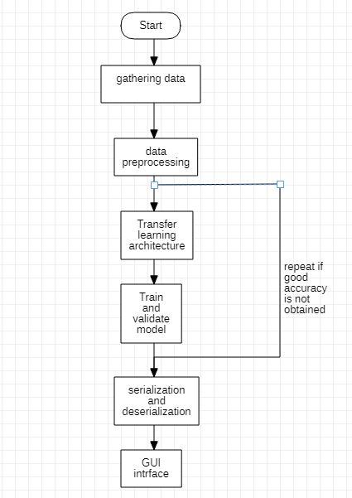
Data Flow diagram

Slide 10
Data Preprocessing
Image processing :
It is a method to perform some operations on an image, in order to get some useful information from it.
Steps involved in image processing are:
Image Acquisition
Image Enhancement
Color Image Processing
Image Segmentation

Slide 11
Image Acquisition
Image acquisition is the first step in image processing. It involves retrieving the image from a source, usually a hardware-based source.OpenCV gives the flexibility to capture image directly from a pre-recorded video stream, camera input feed, or a directory path.
Example:
img = cv2.imread('/content/new plant diseases dataset(augmented)/data/train/Apple___Apple_scab/00075aa8-d81a-4184-8541-b692b78d398a___FREC_Scab 3335.JPG')

Slide 12
Image Enhancement
Image enhancement is the process of adjusting digital images so that the results are more suitable for display or further image analysis. For example, you can remove noise, sharpen, or brighten an image, making it easier to identify key features.
# image Enhancement:
lower_green = np.array([25,0,20])
upper_green = np.array([100,255,255])
mask = cv2.inRange(hsv_img, lower_green, upper_green)
result = cv2.bitwise_and(img, img, mask=mask)
plt.figure(figsize=(15,15))
plt.subplot(1, 2, 1)
plt.imshow(mask, cmap="gray")
plt.subplot(1, 2, 2)
plt.imshow(result)

Slide 13
Color Image Processing
In color image processing, an abstract mathematical model known as color space is used to characterize the colors in terms of intensity values. This color space uses a three-dimensional coordinate system. RGB is the default color space.
# lets change the color from BGR to RGB
img = cv2.imread('/content/new plant diseases dataset(augmented)/data/train/Apple___healthy/03d420e7-42a1-41d8-9600-16d577043c64___RS_HL 5738.JPG')
plt.subplot(1,2,1)
plt.imshow(img)
plt.subplot(1, 2, 2)
img = cv2.cvtColor(img, cv2.COLOR_BGR2RGB)
plt.imshow(img)
plt.show()
hsv_img = cv2.cvtColor(img, cv2.COLOR_RGB2HSV)
gray_image = cv2.cvtColor(img,cv2.COLOR_BGR2GRAY)
sketch_image=cv2.divide(gray_image,inverted_image, scale=256.0)
pencil_sketch=cv2.cvtColor(sketch_image, cv2.COLOR_BGR2RGB)

Slide 14
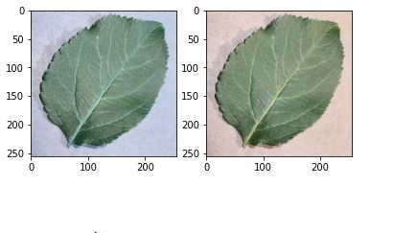
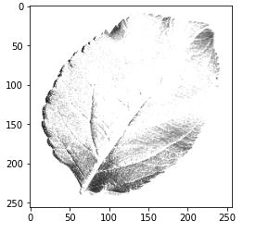
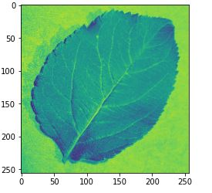
BGR2RGB
Sketch image
BGR2GRAY

Slide 15
Image Segmentation
Image segmentation is a method in which a digital image is broken down into various subgroups called Image segments which helps in reducing the complexity of the image to make further processing or analysis of the image simpler.
Types of Image Segmentation:
Image Segmentation using edge detection
Image Segmentation using K means
Image Segmentation using Contour Detection
Image Segmentation using Color Masking

Slide 16
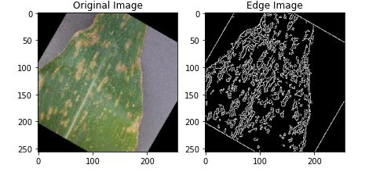
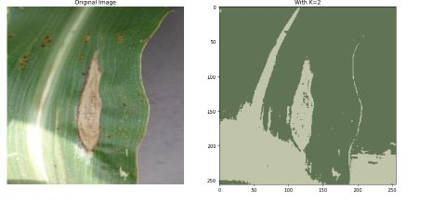
Edge Detection
K-means

Slide 17
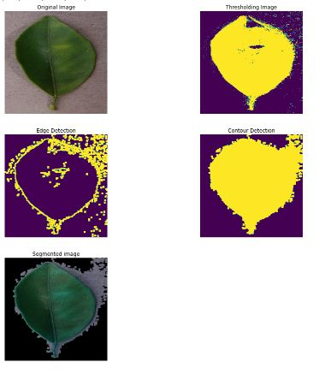
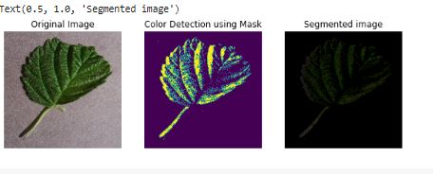
Color masking
Contour Detection

Slide 18
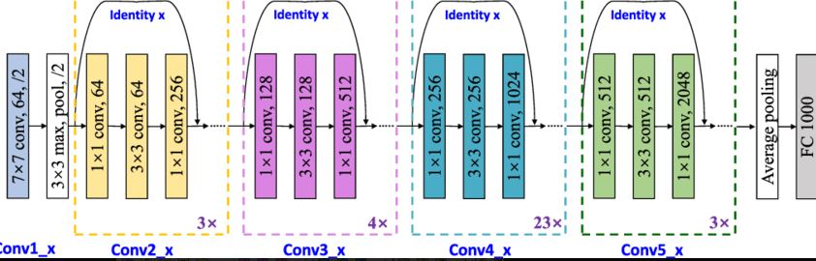
Model
Resnet
ResNet-101 is a convolutional neural network that is 101 layers deep.This model gives an Train accuracy:99.58 and validation accuracy:95.83.for 10 epochs.

Slide 19
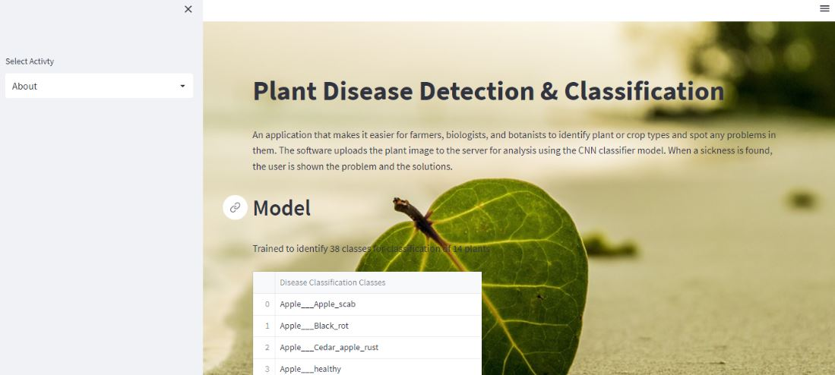
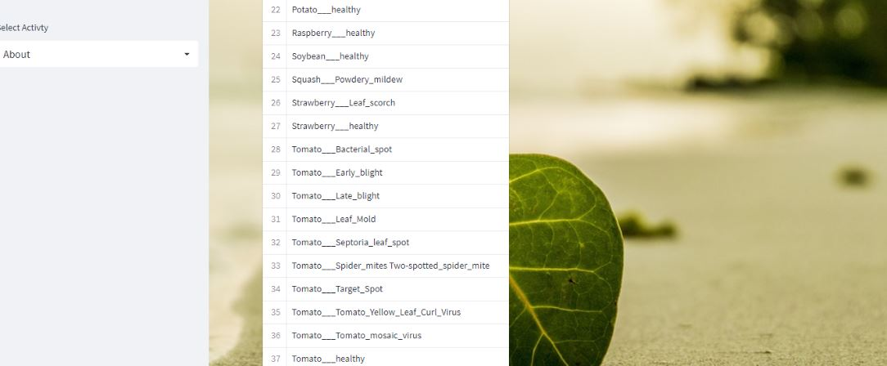
Streamlit Application
Description about our application:

Slide 20
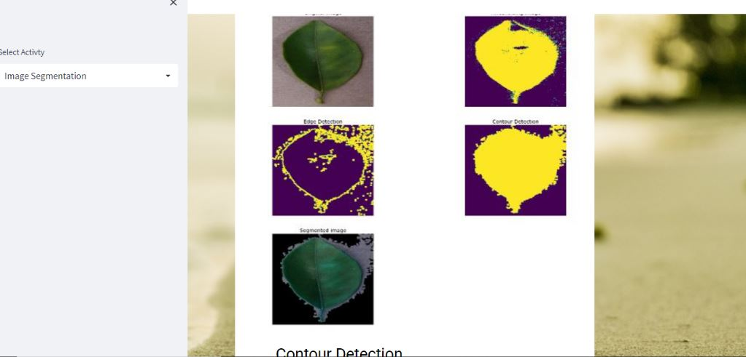
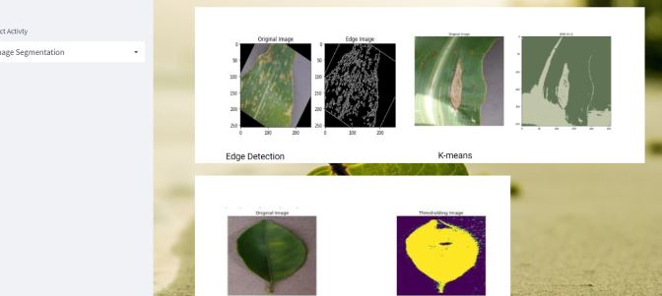
Image Segmentation:

Slide 21
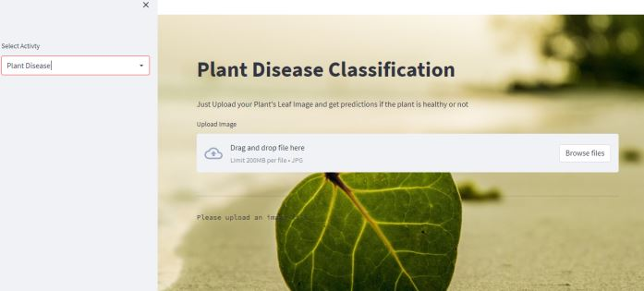
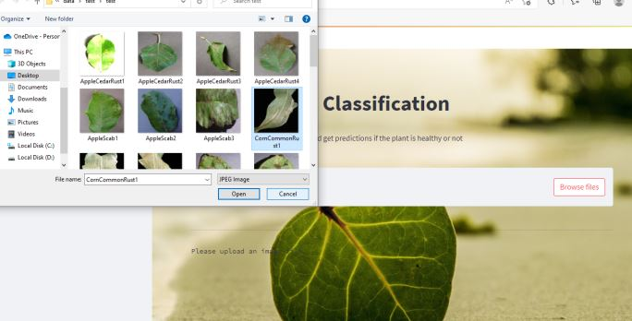
Plant Disease Detection:

Slide 22
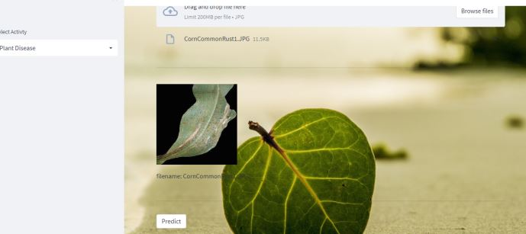
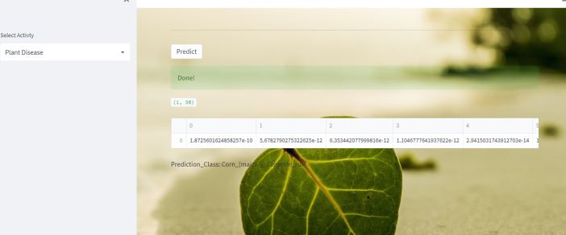

Slide 23
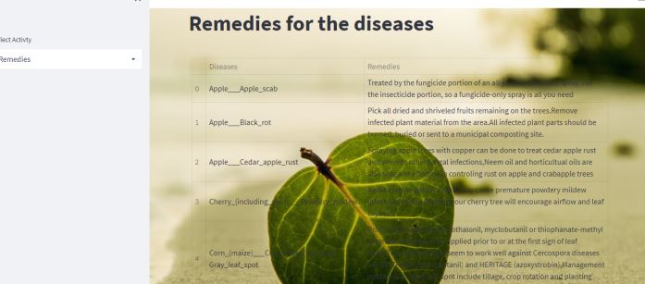
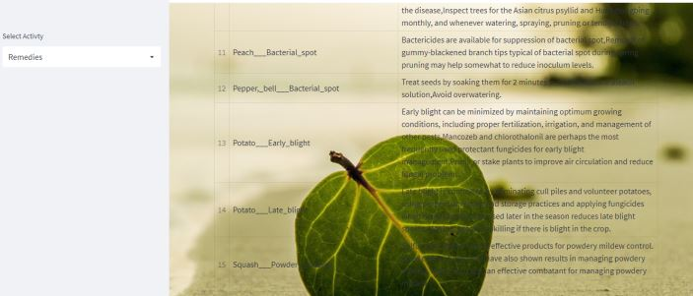
Remedies:

Slide 24
Conclusion and future scope of the project.
As the forecasting of the disease is done at the early stage ,so that appropriate measures can be taken to prevent the crop loss.
Our project is capable of detecting the disease at the early stage as soon as it occurs on the leaf .
Creating and training a CNN model from scratch is a challenging task ,This model can be used to detect and classify the other plant diseases too,by simply training the model using respected datasets.

Slide 25
Q&A

Slide 26
Thank You

